Slide 1
End-to-end Speech Recognition
Ji-Hwan Kim
Sogang University
Dept. of Computer Science and Engineering

Slide 2
목 차
1. End-to-end 음성인식 개요
1.1 HMM 기반 음성인식의 단점
1.2 HMM과 End-to-end 음성인식과의 비교
2. End-to-end 음성인식 기술
2.1 Connectionist Temporal Classification (CTC)
2.2 Attention Network
2.3 RNN-Transducer
Notes:
내용 추가

Slide 3
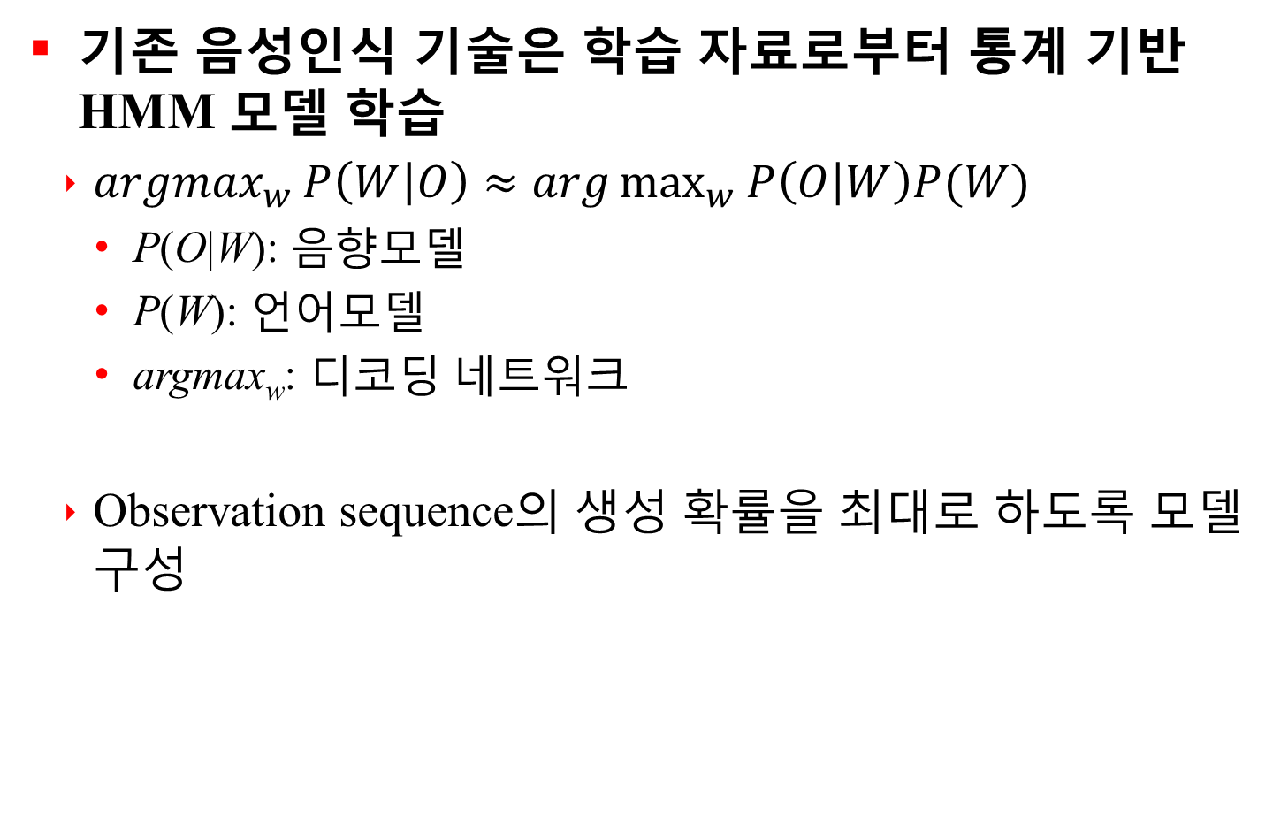
1.1 HMM 기반 음성인식의 단점
기존 음성인식 기술은 학습 자료로부터 통계 기반 HMM 모델 학습
$\underset{w}{argmax}{P\left(W | O\right)≈arg\max_{w}{P\left(O | W\right)P(W)}}$
P(O|W): 음향모델
P(W): 언어모델
argmax_{w}: 디코딩 네트워크
Observation sequence의 생성 확률을 최대로 하도록 모델 구성
여러 개의 component로 구성됨
Notes:
내용 추가

Slide 4
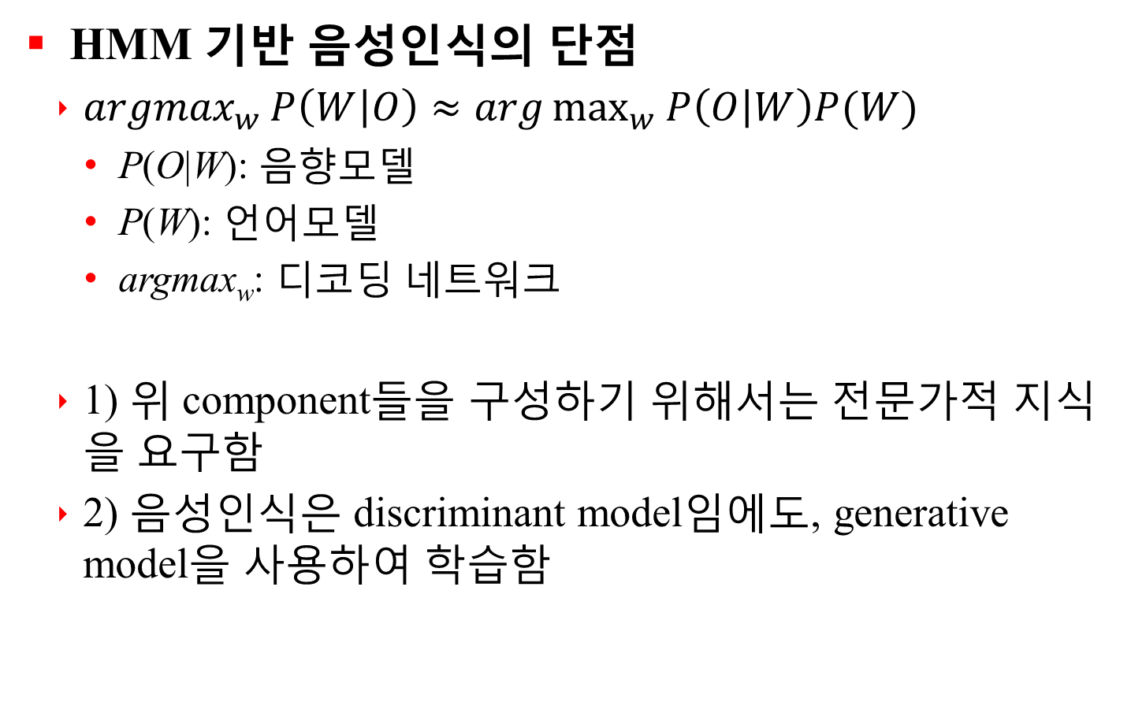
1.1 HMM 기반 음성인식의 단점
HMM 기반 음성인식의 단점
$\underset{w}{argmax}{P\left(W | O\right)≈arg\max_{w}{P\left(O | W\right)P(W)}}$
P(O|W): 음향모델
P(W): 언어모델
argmax_{w}: 디코딩 네트워크
1) 위 component들을 구성하기 위해서는 전문가적 지식을 요구함
2) 음성인식은 discriminant model임에도, generative model을 사용하여 학습함
여러 개의 component로 구성됨
Notes:
내용 추가

Slide 5
1.2 HMM과 End-to-end 음성인식과의 비교
End-to-end 음성인식
입력된 신호 정보에 대해 GMM-HMM 모델의 aligned label 없이 neural network 모델에 기반하여 음소열 또는 문자열 출력
Hybrid 모델(ex. DNN-HMM 모델)은 입력된 신호 정보의 매 frame에 대응되는 aligned label을 요구
이론상 어휘사전 및 언어 모델을 사용하지 않음
구현의 측면에서 성능 향상을 위해 언어 모델 사용
Notes:
내용 추가

Slide 6
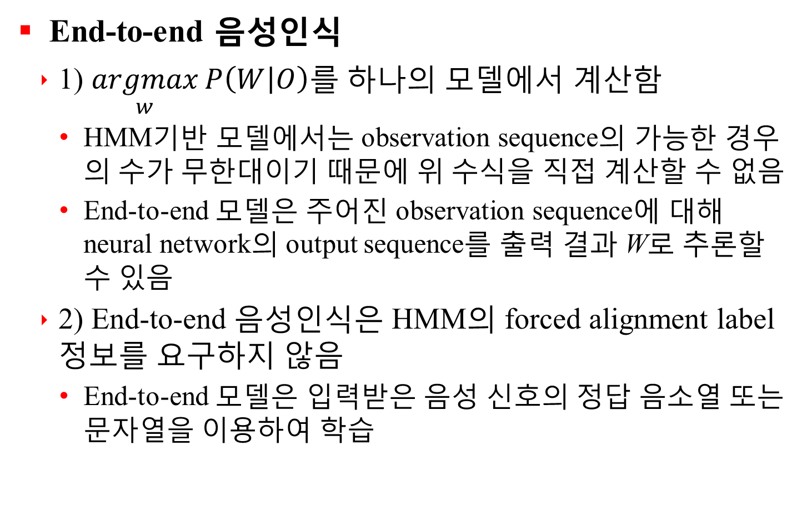
1.2 HMM과 End-to-end 음성인식과의 비교
End-to-end 음성인식
1) $\underset{w}{argmax}{P\left(W | O\right)}$를 하나의 모델에서 계산함
HMM기반 모델에서는 observation sequence의 가능한 경우의 수가 무한대이기 때문에 위 수식을 직접 계산할 수 없음
End-to-end 모델은 주어진 observation sequence에 대해 neural network의 output sequence를 출력 결과 W로 추론할 수 있음
2) End-to-end 음성인식은 HMM의 forced alignment label 정보를 요구하지 않음
End-to-end 모델은 입력받은 음성 신호의 정답 음소열 또는 문자열을 이용하여 학습
Notes:
내용 추가

Slide 7
2. End-to-end 음성인식 기술
2.1 Connectionist Temporal Classification (CTC)
2.2 Attention Network
2.3 RNN-Transducer
Notes:
내용 추가

Slide 8
2.1 Connectionist Temporal Classification (CTC)
Introduction
Object
RNN training to label unsegmented sequences directly
Drawbacks of HMM for sequence labelling
Require a significant amount of task specific knowledge to design the state models
Require explicit dependency assumptions that observations are independent for HMMs
HMMs training is generative even though sequence labelling is discriminative
Notes:
내용 추가

Slide 9
2.1 Connectionist Temporal Classification (CTC)
Introduction
RNN provides a powerful, general mechanism for modelling time series, but RNN can only be trained to make a series of independent label classifications
Training data must be pre-segmented
Network output must be post processed to give the final label sequence
Hybrid approach for sequence labelling at present: RNN combine with HMM
HMMs to model the long range sequential structure of the data
RNNs to provide localized classifications
Notes:
내용 추가

Slide 10
2.1 Connectionist Temporal Classification (CTC)
Temporal Classification
S : training examples set
Input space : set of all sequence of m dimensional real valued vectors
Target space : set of all sequences over the alphabet L of labels
S consists of a pair of sequences (x, z)
Target sequence
Input sequence
Train a temporal classifier in a way that minimizes some task specific error measure
Notes:
내용 추가

Slide 11

2.1 Connectionist Temporal Classification (CTC)
Temporal Classification
Label Error Rate (LER)
Test set
ED(p, q) is the edit distance between two sequence p and q
eg) the minimum number of insertions, substitutions and deletions required to change p and q
Notes:
내용 추가

Slide 12
2.1 Connectionist Temporal Classification (CTC)
Connectionist Temporal Classification
From Network Outputs to Labellings
CTC network
Softmax output layer with one more unit than there are labels in L
Extra unit is a ‘blank’, or no label
CTC network output
the probabilities of all possible ways of aligning all possible label sequences with the input sequence
Total probability of any one label sequence
summing the probabilities of its different alignments
Notes:
내용 추가

Slide 13

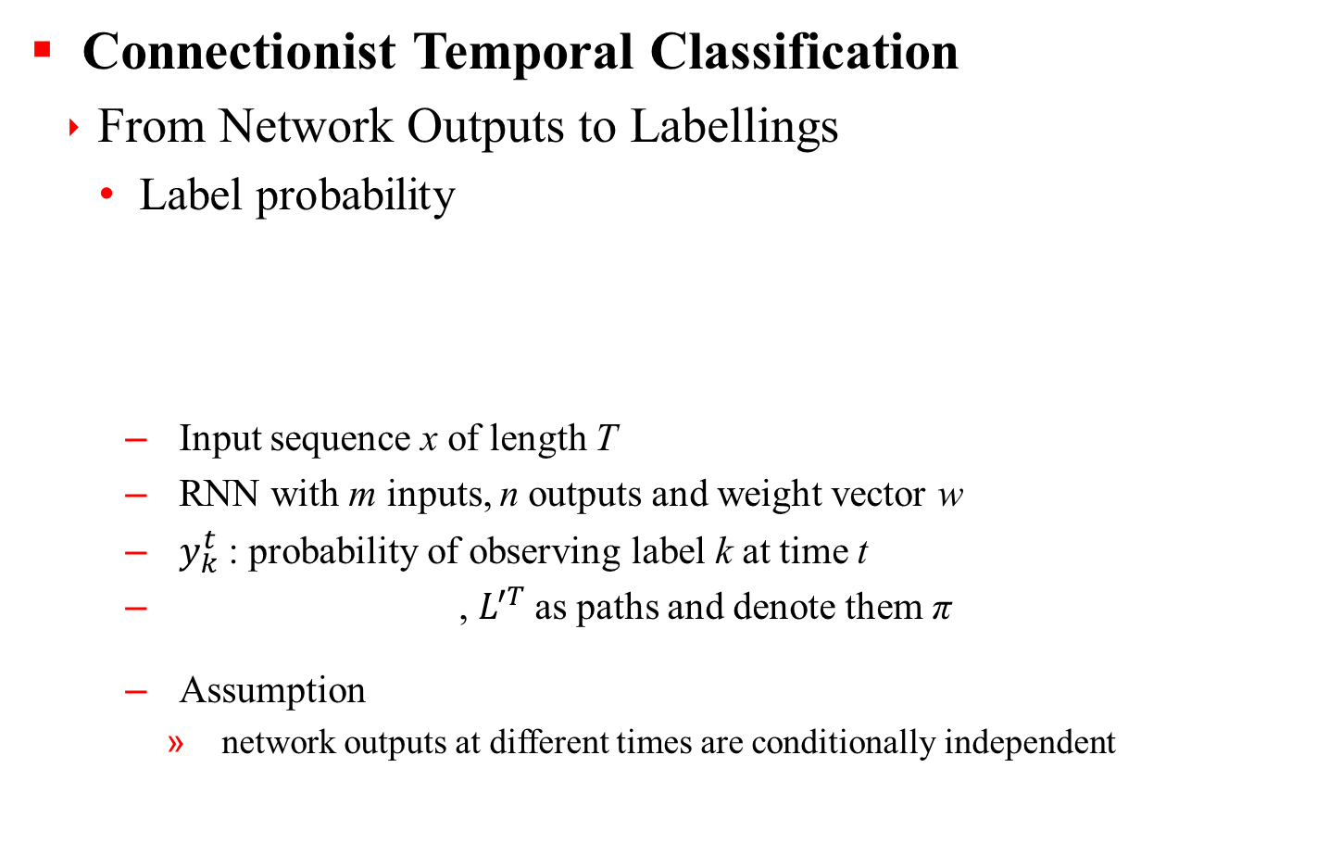
2.1 Connectionist Temporal Classification (CTC)
Connectionist Temporal Classification
From Network Outputs to Labellings
Label probability
Input sequence x of length T
RNN with m inputs, n outputs and weight vector w
$y_{k}^{t}$ : probability of observing label k at time t
, $L^{′T}$as paths and denote them π
Assumption
network outputs at different times are conditionally independent
Notes:
내용 추가

Slide 14


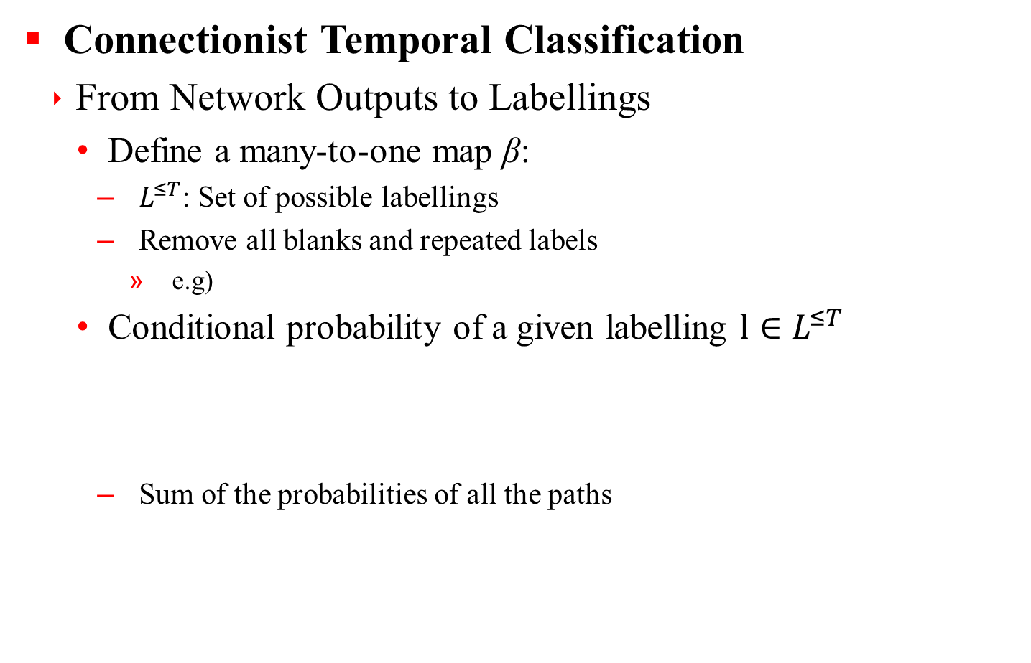
2.1 Connectionist Temporal Classification (CTC)
Connectionist Temporal Classification
From Network Outputs to Labellings
Define a many-to-one map β:
$L^{≤T}$: Set of possible labellings
Remove all blanks and repeated labels
e.g)
Conditional probability of a given labelling $l∈L^{≤T}$
Sum of the probabilities of all the paths
Notes:
내용 추가

Slide 15


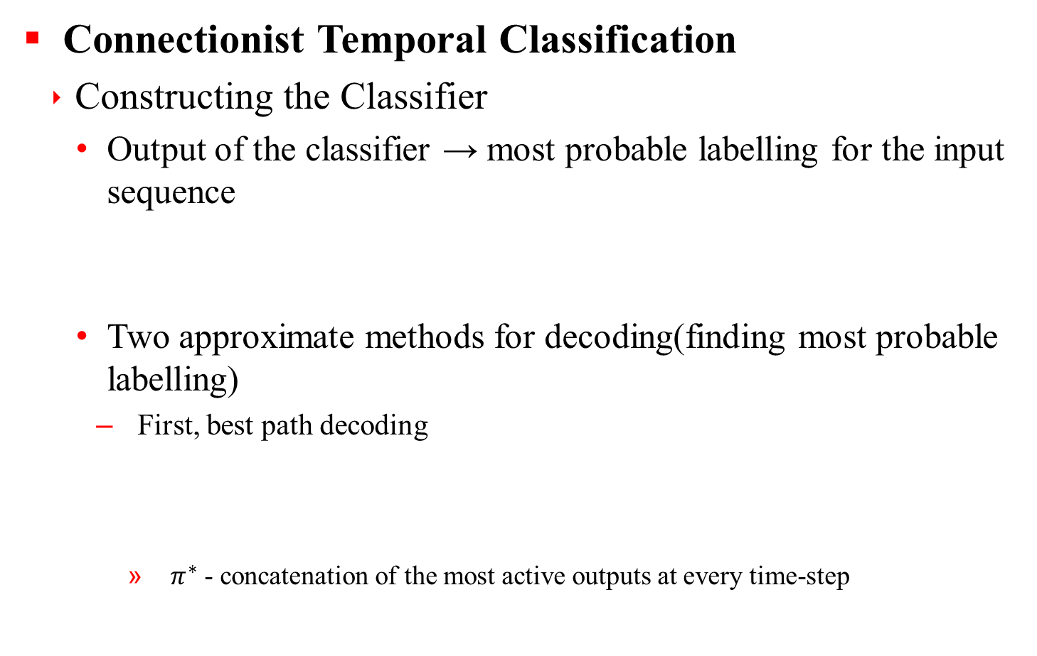
2.1 Connectionist Temporal Classification (CTC)
Connectionist Temporal Classification
Constructing the Classifier
Output of the classifier → most probable labelling for the input sequence
Two approximate methods for decoding(finding most probable labelling)
First, best path decoding
$π^{∗}$ - concatenation of the most active outputs at every time-step
Notes:
내용 추가

Slide 16
2.1 Connectionist Temporal Classification (CTC)
Connectionist Temporal Classification
Constructing the Classifier
Two approximate methods for decoding(finding most probable labelling)
Second, prefix search decoding
Given enough time, prefix search decoding always finds the most probable labelling
Step
Divide output sequence into sections that are very likely to begin and end with a blank
Choose boundary points where a blank label is above a certain threshold
Calculate the most probable labelling for each section and concatenate these
Notes:
내용 추가

Slide 17
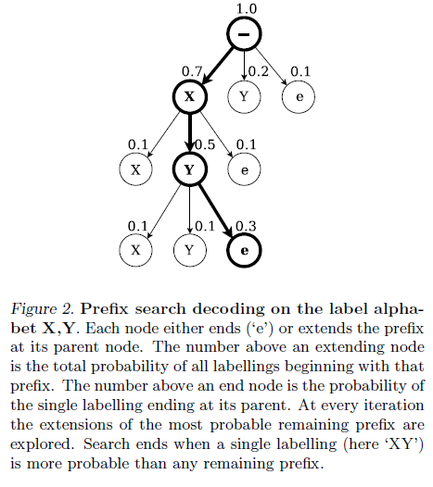
2.1 Connectionist Temporal Classification (CTC)
Connectionist Temporal Classification
Constructing the Classifier
Two approximate methods for decoding(finding most probable labelling)
Second, prefix search decoding
Notes:
내용 추가

Slide 18
2.1 Connectionist Temporal Classification (CTC)
Training the Network
Derive objective function for training CTC networks with gradient descent
Objective function(loss function): maximum likelihood function
Same principle underlying the standard neural network objective functions
Notes:
내용 추가

Slide 19

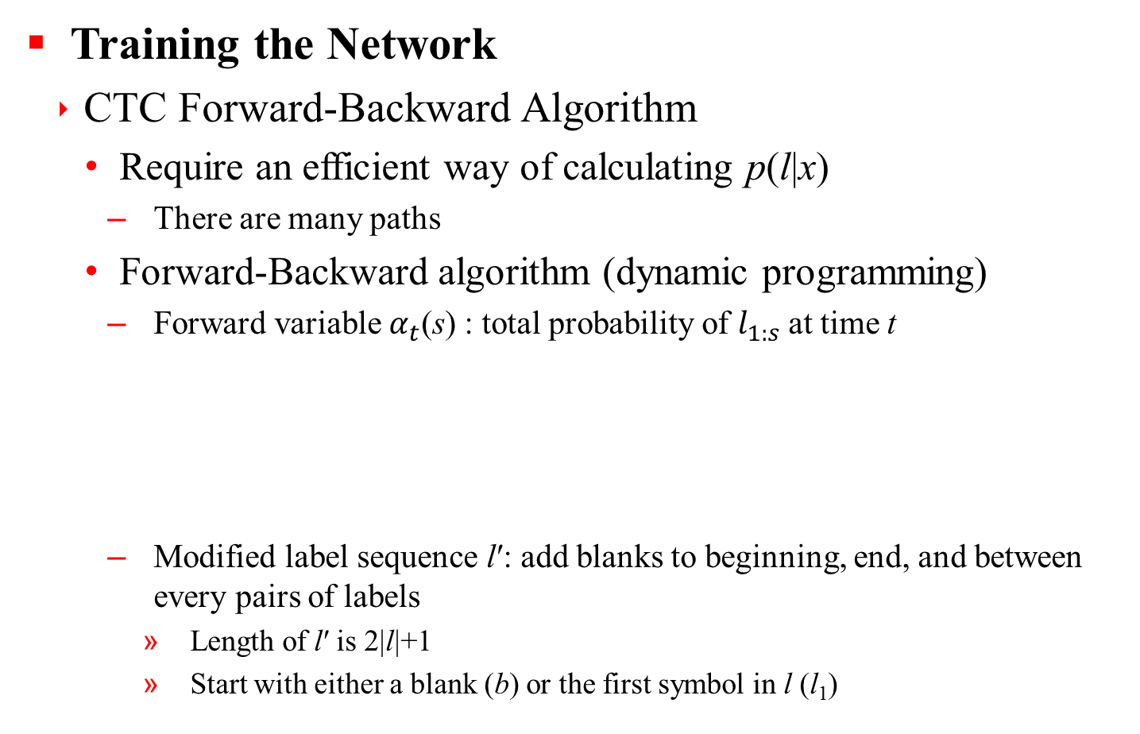
2.1 Connectionist Temporal Classification (CTC)
Training the Network
CTC Forward-Backward Algorithm
Require an efficient way of calculating p(l|x)
There are many paths
Forward-Backward algorithm (dynamic programming)
Forward variable $α_{t}$(s) : total probability of $l_{1:s}$at time t
Modified label sequence l′: add blanks to beginning, end, and between every pairs of labels
Length of l′ is 2|l|+1
Start with either a blank (b) or the first symbol in l (l₁)
Notes:
내용 추가

Slide 20
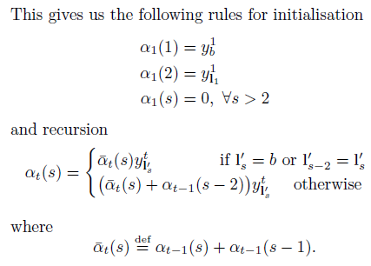

2.1 Connectionist Temporal Classification (CTC)
Training the Network
CTC Forward-Backward Algorithm
Probability of l
Notes:
내용 추가

Slide 21
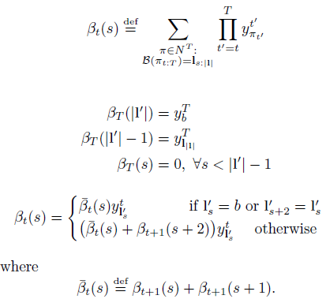

2.1 Connectionist Temporal Classification (CTC)
Training the Network
CTC Forward-Backward Algorithm
Forward variable $β_{t}(s)$: total probability of $l_{s:|l|}$ at time t
Notes:
내용 추가

Slide 22
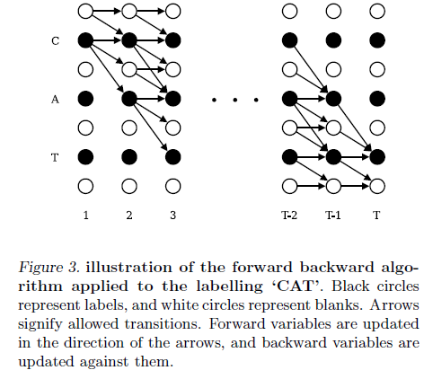
2.1 Connectionist Temporal Classification (CTC)
Training the Network
CTC Forward-Backward Algorithm
Notes:
내용 추가

Slide 23



2.1 Connectionist Temporal Classification (CTC)
Training the Network
CTC Forward-Backward Algorithm
Rescale 𝛼, 𝛽 to avoid underflow
To evaluate the maximum likelihood error, make natural log form
Notes:
내용 추가

Slide 24


2.1 Connectionist Temporal Classification (CTC)
Training the Network
Maximum Likelihood Training
Maximize the log probabilities of all the correct classifications in the training set
In our case, minimize the following objective function
Differentiate with respect to the network outputs to train network with gradient descent
Notes:
내용 추가

Slide 25

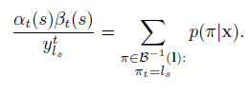
2.1 Connectionist Temporal Classification (CTC)
Training the Network
Maximum Likelihood Training
Product of the forward and backward variables at a given s and time t
Notes:
내용 추가

Slide 26

2.1 Connectionist Temporal Classification (CTC)
Training the Network
Maximum Likelihood Training
Total probability p(l | x) : sum over all s and t
Notes:
내용 추가

Slide 27
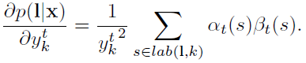

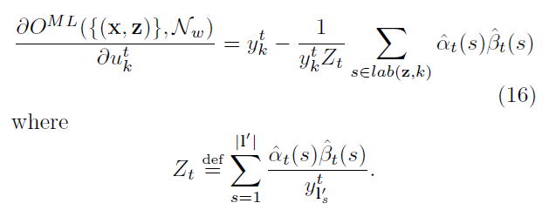
2.1 Connectionist Temporal Classification (CTC)
Training the Network
Maximum Likelihood Training
Differentiate p(l | x)
Notes:
내용 추가

Slide 28
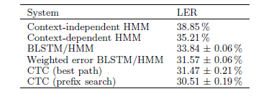
2.1 Connectionist Temporal Classification (CTC)
Experiment
BLSTM architecture: 100 blocks in each of forward and backward hidden layers
Input layer size: 26 (MFCC 13 + 1ST delta)
Output layer size: 62 (61 phoneme + blank)
Blank probability threshold 99.99% for prefix search decoding
Notes:
내용 추가

Slide 29
2.2 Attention Network
Recurrent Neural Network
Suited for sequences of data
“The sky is blue”
Networks with loops in them, allowing information to persist
RNN is trained by BPTT (Back-Propagation Through Time)
Notes:
내용 추가

Slide 30
2.2 Attention Network
LSTM (Long-Short Term Memory)
Hard to capture long-term dependencies (a.k.a. Vanishing Gradient)
“I grew up in France (…) I speak French”
Special kind of RNN capable of learning long-term dependencies
LSTM unit can choose to retain/forget its memory
Notes:
내용 추가

Slide 31
2.2 Attention Network
Bidirectional LSTM
BLSTM has forward/backward LSTM layers
Deep BLSTM has many BLSTM layers
Notes:
내용 추가

Slide 32
2.2 Attention Network
Generating Language
Given a series of symbols 𝑊₁𝑊₂…𝑊_{𝑛}, predict the next symbol 𝑊_{𝑛+1}
Trained via backpropagation from a lot of text
Notes:
내용 추가

Slide 33
2.2 Attention Network
Sequence to Sequence Model
𝑥₁…𝑥_{𝑛} → 𝑦₁…𝑦_{𝑚} (𝑛≠𝑚)
e.g.) Machine translation, Speech recognition
Notes:
내용 추가

Slide 34
2.2 Attention Network
Simple Translation Model
RNN hidden state stores “all information” about what have seen so far (i.e. 𝑥,𝑦_{1…𝑡})
Decoder produces 𝑃(𝑦_{𝑡+1} 𝑦_{1…𝑡},𝑥)
Special symbol <eos> indicates “end-of-string”
Notes:
내용 추가

Slide 35
2.2 Attention Network
Decoding
At each time decoder outputs distribution over vocabulary
Do beam search for decoding
Fork the network; Retain top 𝑘 scoring forks
Notes:
내용 추가

Slide 36
2.2 Attention Network
Training – Forward Pass
Forward pass: Input the source and target sequences, sequentially
Output will be a probability distribution over vocabulary
Notes:
내용 추가

Slide 37
2.2 Attention Network
Training – Backward Pass
Compute divergence between output distribution and target word sequence
Stochastic Gradient Descent
Randomly select training instance: (input, output)
Forward pass
Randomly select a single output and target output for backpropagation
Notes:
내용 추가

Slide 38
2.2 Attention Network
Training – Backward Pass
Notes:
내용 추가

Slide 39
2.2 Attention Network
Problem in Training
In reality: All hidden values carry information
Some of which may be diluted downstream
Different outputs are related to different inputs
Notes:
내용 추가

Slide 40
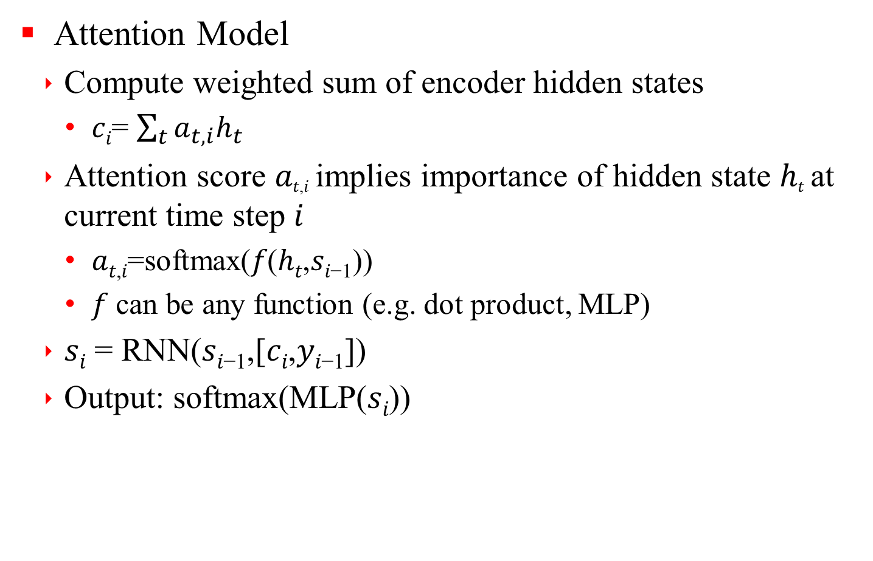
2.2 Attention Network
Attention Model
Compute weighted sum of encoder hidden states
𝑐_{𝑖}= $\sum_{t}{a_{t,i}h_{t}}$
Attention score 𝑎_{𝑡,𝑖} implies importance of hidden state ℎ_{𝑡} at current time step 𝑖
𝑎_{𝑡,𝑖}=softmax(𝑓(ℎ_{𝑡},𝑠_{𝑖−1}))
𝑓 can be any function (e.g. dot product, MLP)
𝑠_{𝑖} = RNN(𝑠_{𝑖−1},[𝑐_{𝑖},𝑦_{𝑖−1}])
Output: softmax(MLP(𝑠_{𝑖}))
Notes:
내용 추가

Slide 41
2.2 Attention Network
Attention Model
Notes:
내용 추가

Slide 42
2.2 Attention Network
Attention Example
Notes:
내용 추가

Slide 43

2.2 Attention Network
Listen Attend Spell (LAS) Model
Directly apply seq2seq to speech
Now, input is audio
Pyramidical RNN (pRNN)
$h_{t}^{j}=pRNN(h_{t−1}^{j},\left[h_{2t}^{j−1},h_{2t+1}^{j−1}\right])$
Notes:
내용 추가

Slide 44
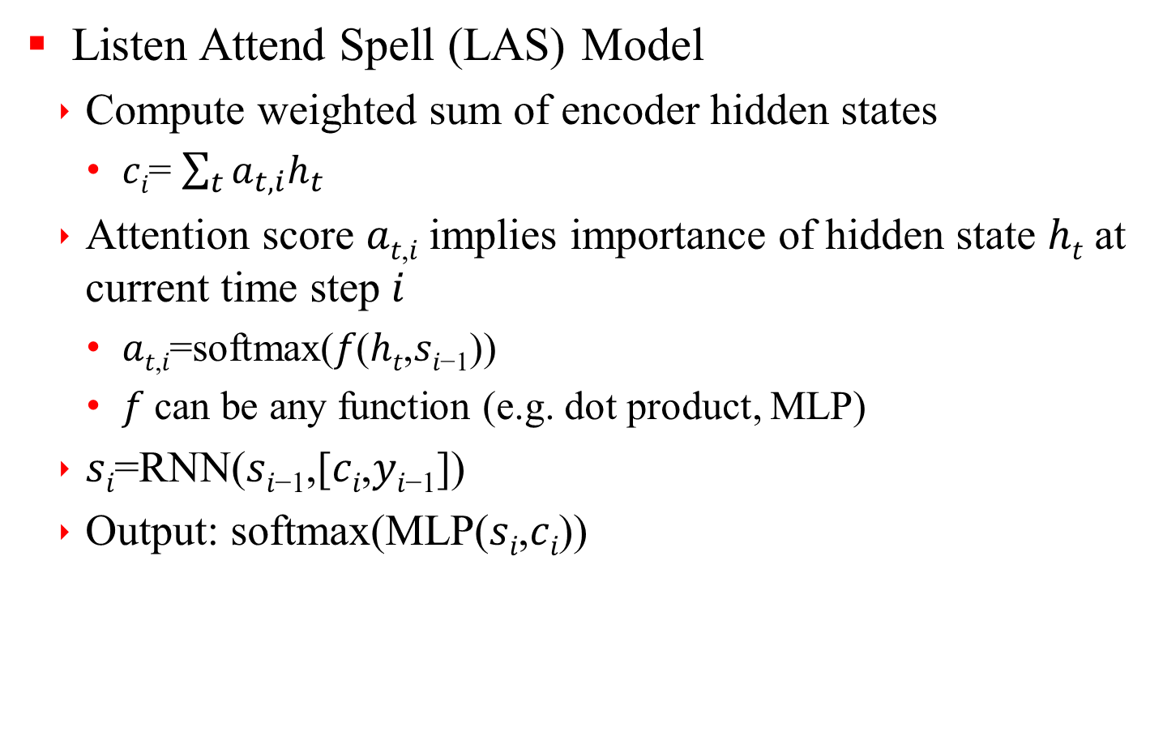
2.2 Attention Network
Listen Attend Spell (LAS) Model
Compute weighted sum of encoder hidden states
𝑐_{𝑖}= $\sum_{t}{a_{t,i}h_{t}}$
Attention score 𝑎_{𝑡,𝑖} implies importance of hidden state ℎ_{𝑡} at current time step 𝑖
𝑎_{𝑡,𝑖}=softmax(𝑓(ℎ_{𝑡},𝑠_{𝑖−1}))
𝑓 can be any function (e.g. dot product, MLP)
𝑠_{𝑖}=RNN(𝑠_{𝑖−1},[𝑐_{𝑖},𝑦_{𝑖−1}])
Output: softmax(MLP(𝑠_{𝑖},𝑐_{𝑖}))
Notes:
내용 추가

Slide 45
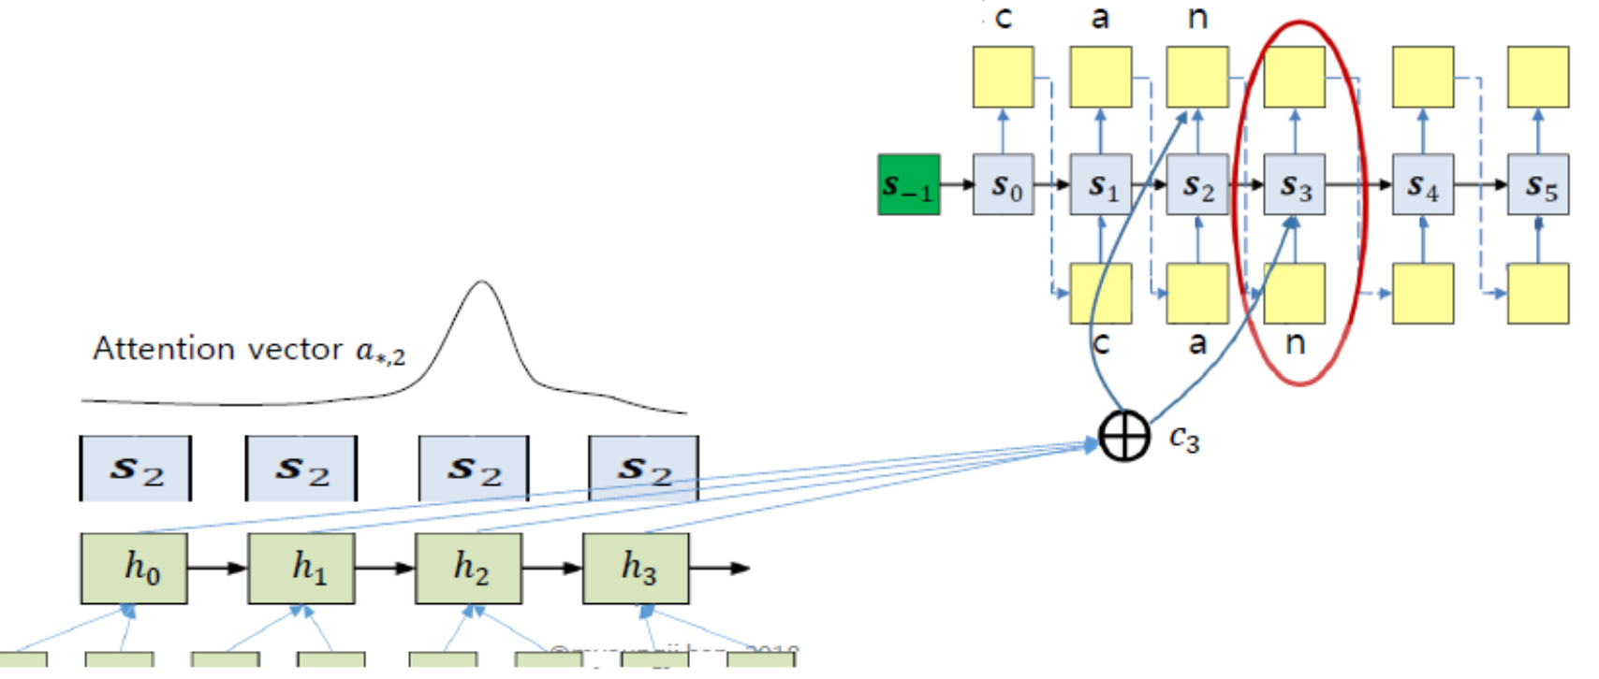
2.2 Attention Network
Listen Attend Spell (LAS) Model
Notes:
내용 추가

Slide 46
2.2 Attention Network
Listen Attend Spell (LAS) example
Notes:
내용 추가

Slide 47
2.2 Attention Network
Optimization Techniques for LAS
Structure improvements
Word Piece Model
Grapheme-level LM is hard to learn
Longer units make decoding memory efficient
Finite set of words cause OOV
Keep frequent words, split rare words into sub-word units (wordpieces)
Multi-Headed Attention
Extends attention to have multiple heads, where each head generate different attention distribution
Notes:
내용 추가

Slide 48
2.2 Attention Network
Optimization Techniques for LAS
Optimization improvements
MWER Training
Use MWER as loss function
Scheduled Sampling
Feeding ground-truth label as previous prediction helps decoder to learn quickly
Mismatch between training and inference
Sometimes sample output from previous prediction
Notes:
내용 추가

Slide 49
2.2 Attention Network
Optimization Techniques for LAS
Optimization improvements
Synchronous Training
Distributed computation of gradients for minibatch in SGD
Wait for all workers to send their gradients and aggregate them
Label smoothing
Regularization mechanism to prevent over-confident prediction
Smoothe ground-truth label distribution with uniform distribution over all inputs
2-Pass Rescoring
LAS automatically learns LM, but limited to training transcripts
Rescore 𝑁-best hypotheses using large 5-gram LM trained on text data from various domains
Notes:
내용 추가

Slide 50
2.2 Attention Network
Experiments
12,500 hour training set consisting of 15 million English utterances
Anonymized & hand-transcribed on Google’s voice search traffic
Room simulator to add noise and reverberation (0~30dB SNR, 12dB in average)
80-dimensional log-Mel features, 25ms window shifted every 1ms
Features are stacked with 3 frames to the left and downsampled to a 30ms frame rate
Notes:
내용 추가

Slide 51
2.2 Attention Network
Experiments
Encoder : 5 LSTM layers
Unidirectional : 1,400 hidden units
Bidirectional : 1,024 hidden units in each direction
Decoder
2 LSTM layers with 1,024 hidden units per layer
Notes:
내용 추가

Slide 52
2.2 Attention Network
Experiments
Tested on ~14.8K voice search traffic & 15.7K dictation utterances
Compare to SOTM discriminatively sequence-trained low frame rate (LFR) system
Notes:
내용 추가

Slide 53
2.3 RNN-Transducer
Introduction
End-to-End probabilistic sequence transduction system based on RNN
Experimental result with TIMIT DB
CTC on RNN
Prediction Network
Notes:
내용 추가

Slide 54

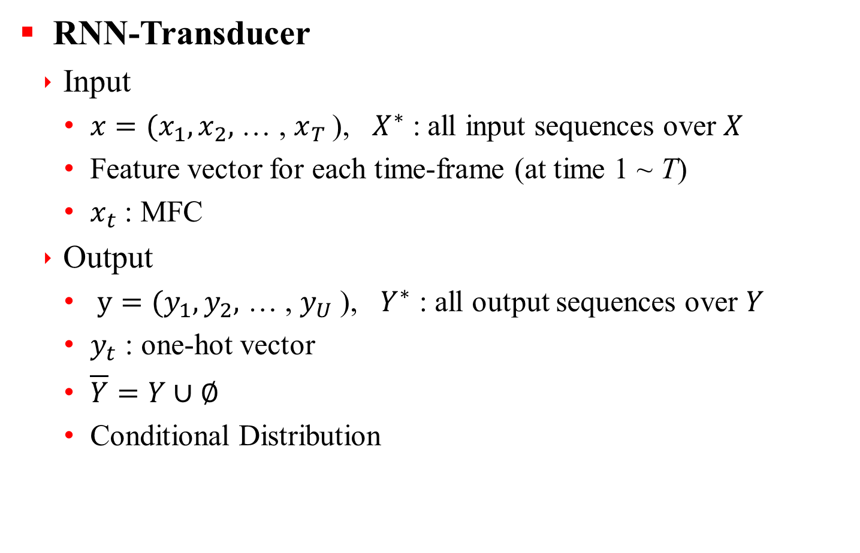
2.3 RNN-Transducer
RNN-Transducer
Input
$x=(x_{1},x_{2},$ … , $x_{T}$), $X^{∗}$ : all input sequences over $X$
Feature vector for each time-frame (at time 1 ~ T)
$x_{t}$ : MFC
Output
$y=(y_{1},y_{2},$ … , $y_{U}$), $Y^{∗}$ : all output sequences over $Y$
$y_{t}$ : one-hot vector
$\overline{Y}=Y∪∅$
Conditional Distribution
Notes:
내용 추가

Slide 55

2.3 RNN-Transducer
RNN-Transducer
Structure
F : transcription network : scan $x → f=(f_{1},f_{2},$ … , $f_{T}$)
G : prediction network : scan $y →g=(g_{1},g_{2},$ … , $g_{U}$) : prediction vector
Notes:
내용 추가

Slide 56


2.3 RNN-Transducer
Prediction Network
RNN with 1-input, 1-hidden, 1-output layer
Input
$\hat{y}=(∅, y_{1},{…,y}_{U}$) : U+1 input sequence
$y_{u}=k$ : all 0 but $k$, size = K
output
size = K +1
Notes:
내용 추가

Slide 57
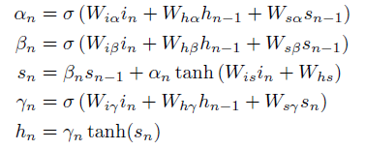
2.3 RNN-Transducer
Prediction Network
RNN w/ 1-input, 1-hidden, 1-output layer
Hidden layer
LSTM RNN
Notes:
내용 추가

Slide 58




2.3 RNN-Transducer
Transcription Network
Bidirectional RNN
Input : $x=(x_{1},x_{2},$ … , $x_{T}$)
Hidden sequence : forward & backward
Backward seq. :
Forward seq. :
Output :
Output
$f=(f_{1},f_{2},$ … , $f_{T}$), size = K+1
Notes:
내용 추가

Slide 59
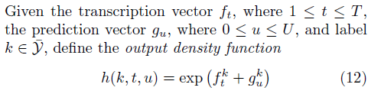

2.3 RNN-Transducer
Output Distribution
Output density ft.
Output distribution (by normalization)
Notes:
내용 추가

Slide 60

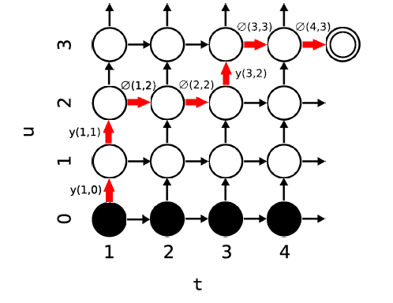
2.3 RNN-Transducer
Output Distribution
Pr⁡(𝑘|𝑡,𝑢) : used for transition probability
Forward-backward Algorithm for efficient calculation
Notes:
내용 추가

Slide 61

2.3 RNN-Transducer
Forward-Backward Algorithm
Forward variable 𝛼(𝑡,𝑢)
Prob. of output 𝑦_{[1:𝑡]} during 𝑓_{[1:𝑡]}
where, 𝛼(1,0)=1
Pr⁡(𝑦│𝑥)=𝛼(𝑇,𝑈)∅(𝑌,𝑈) at terminal
Notes:
내용 추가

Slide 62
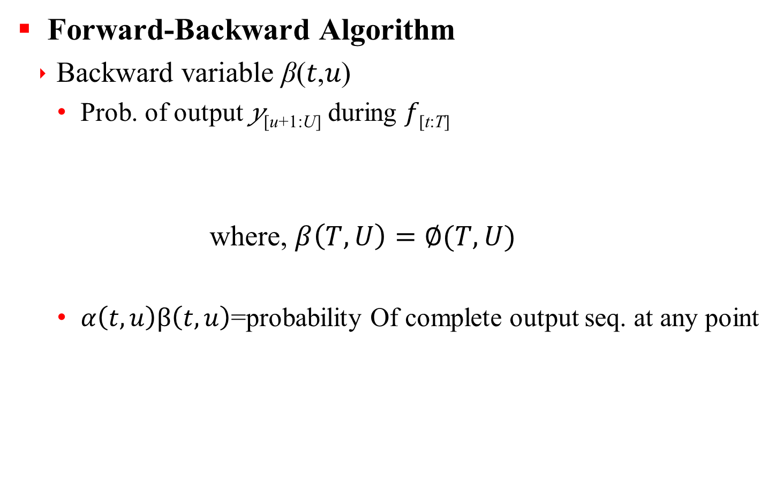
2.3 RNN-Transducer
Forward-Backward Algorithm
Backward variable β(𝑡,𝑢)
Prob. of output 𝑦_{[u+1:U]} during 𝑓_{[t:T]}
where, $β\left(T,U\right)=∅(T,U)$
$α\left(t,u\right)β\left(t,u\right)$=probability Of complete output seq. at any point
Notes:
내용 추가

Slide 63
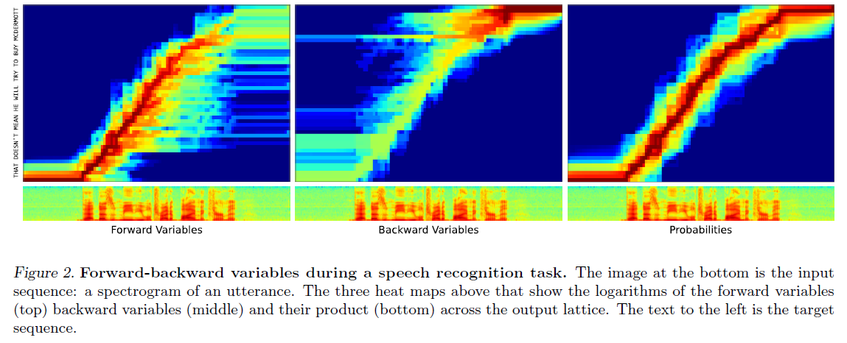
2.3 RNN-Transducer
Forward-backward variables
Notes:
내용 추가

Slide 64
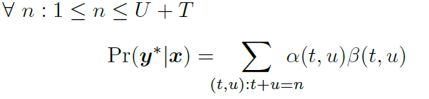
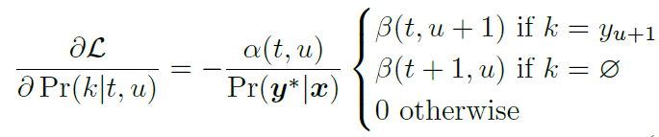

2.3 RNN-Transducer
Training
Minimizing log-loss $L=−\ln{Pr⁡(y^{∗}|x})$of the target sequence.
Calculating gradient of L w.r.t. Network weight
Notes:
내용 추가

Slide 65
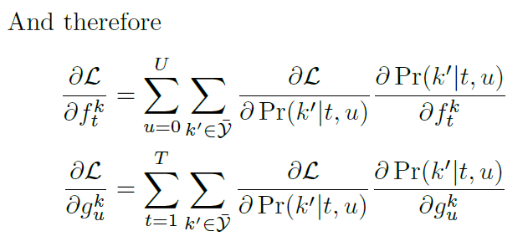
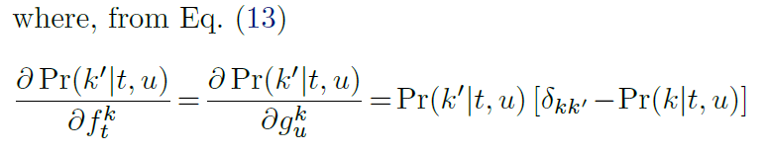
2.3 RNN-Transducer
Training
Notes:
내용 추가

Slide 66

2.3 RNN-Transducer
Training
Gradiant calculation
Using backpropagation with time to each network
Reduce computational load
Precomputing all exp()
using $\exp\left(f+g\right)=\exp\left(f\right)exp⁡(g)$
Notes:
내용 추가

Slide 67
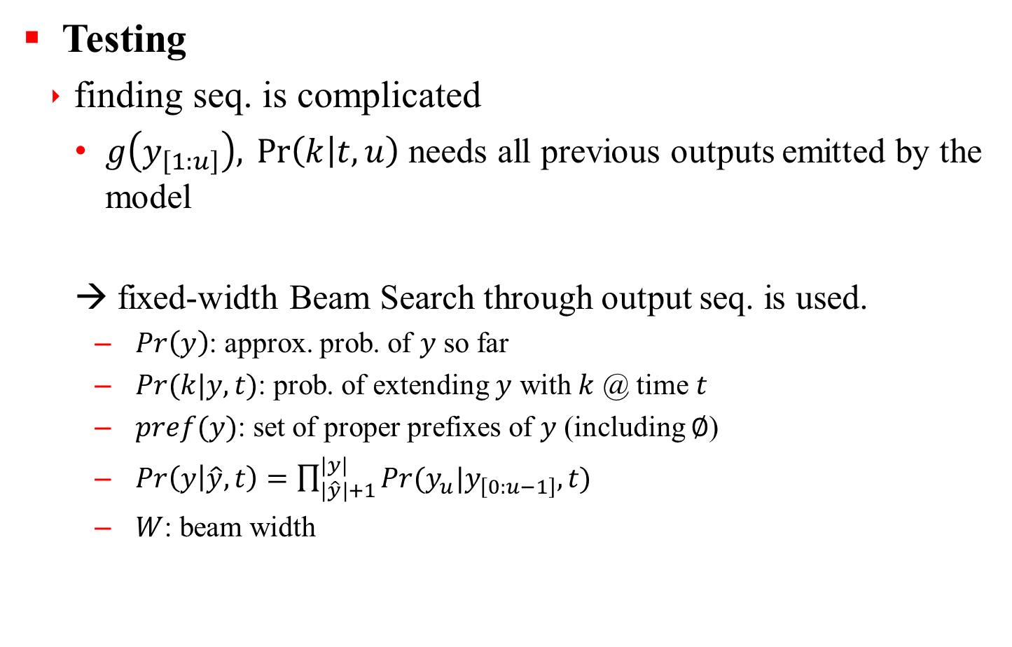
2.3 RNN-Transducer
Testing
finding seq. is complicated
$g\left(y_{\left[1:u\right]}\right),\operatorname{Pr}\left(k | t,u\right)$ needs all previous outputs emitted by the model
→ fixed-width Beam Search through output seq. is used.
$\operatorname{Pr}\left(y\right)$: approx. prob. of $y$ so far
$Pr⁡(k|y,t)$: prob. of extending $y$ with $k$ @ time $t$
$pref(y)$: set of proper prefixes of $y$ (including $∅$)
$\operatorname{Pr}\left(y | \hat{y},t\right)=\prod_{|\hat{y}|+1}^{|y|}{Pr⁡(y_{u}|y_{\left[0:u−1\right]},t)}$
$W$: beam width
Notes:
내용 추가

Slide 68
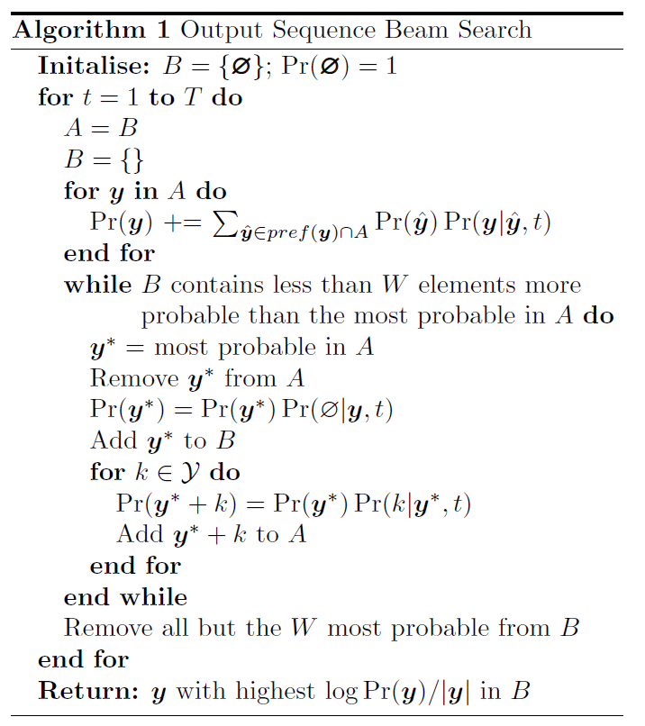
2.3 RNN-Transducer
Testing
Extending to N-best
return sorted list of best N
Length normalization
prevent shorter output seq.
Accelerating Search
at (y+k), storing hidden vectors for all y
→ Reduce computation a lot
Notes:
내용 추가

Slide 69
2.3 RNN-Transducer
Experimental Results
Environments
TIMIT(3696, 192 phone-transcribed utterances)
Validation : using randomly chosen 184 sequence from training set.
Reduced 39 phoneme set for training& testing
26-order MFC (13-order MFC, it’s delta)
Cepstral mean normalization
25ms frame length & 10ms shift
Network parameters
Prediction network : size-28 LSTM hidden layer, 39 input units, 40 output units
Transcription network : 2 size-128 LSTM hidden layer, 26 inputs, 40 outputs → 261K weights in RNN transducer.
Notes:
내용 추가

Slide 70
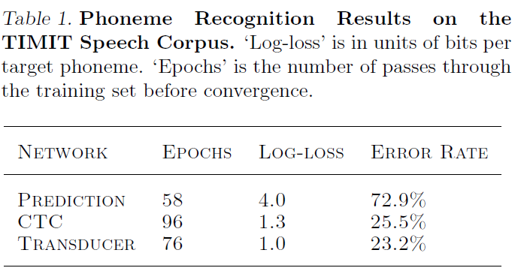
2.3 RNN-Transducer
Experimental Results
Notes:
내용 추가

Slide 71
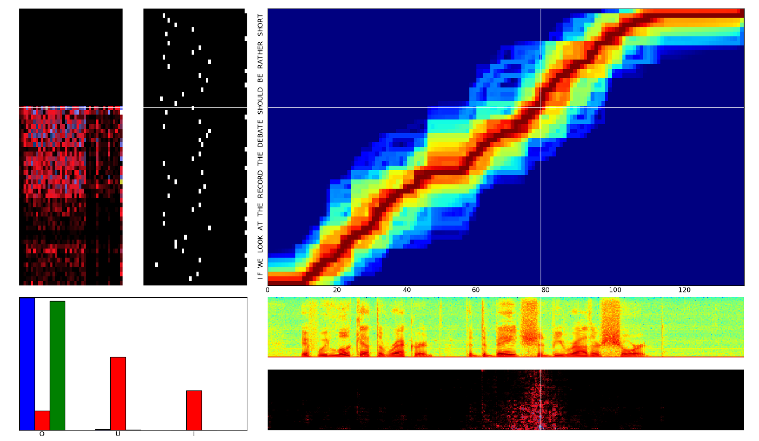
2.3 RNN-Transducer
Experimental Results
Notes:
내용 추가

Slide 72
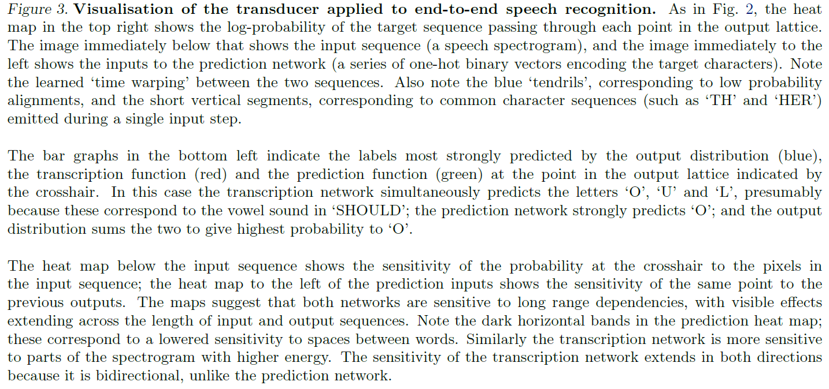
2.3 RNN-Transducer
Experimental Results
Notes:
내용 추가

Slide 73
Q & A
Q & A
Notes:
내용 추가

